Slide 1
OnClick in Fragments
Android Lab

Slide 2
In Activity
Previously, We were using onclick method to handle onclick event.
There is an alternate way to handle that event as well.
By using setonclick listener and onclick listener.
button.setOnClickListener(new View.OnClickListener()); ……

Slide 3
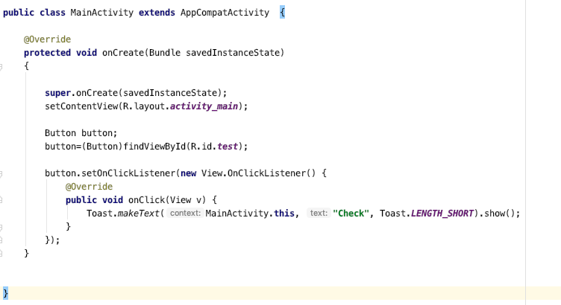

Slide 4
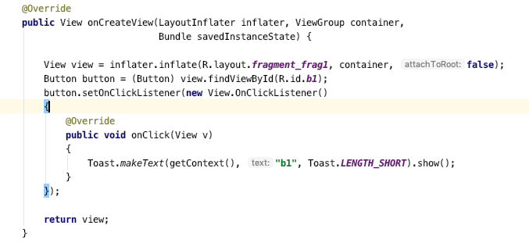
In Fragments

Slide 5
Let's Implement

